Slide 1

Woodcreek Little League GameChanger Training

Slide 2
Agenda
Overview of GC
Lineups
Starting/Scoring a Game
Ending a Game
Practice
Questions

Slide 3
Overview of GameChanger
The Future of WLL Scorekeeping

Slide 4
Overview
For the 2026 season, WLL is moving away from paper scorebooks and will solely utilize GameChanger for AAA, Majors, and Juniors divisions.
Leagues/Organizations have been created and teams have been added.
This allows the league to create schedules in Sports Connect and push those schedules to each team via GameChanger
This also allows division scores, standings, stats, pitch counts, etc. to be visible to teams and league staff.

Slide 5
What is GameChanger?
GameChnager is a mobile app and technology partner of Little League that enables youth teams to live stream games, track stats, and manage scheduling.
It provides automated play-by-play updates, video highlights and in-depth analytics.
Parents are added as “Family Members” in GameChanger by downloading the app (green icon) and creating a free account.
A paid account is also available with more features but is not required.

Slide 6
What do I need to keep score?
Mobile device with GameChanger installed and logged in (i.e. iPhone, iPad).
Internet Connection
Lineups (from both managers)

Slide 7
Who is responsible for scoring a game?
Head to Head Scorekeeping (H2H Scoring) allows one team to score the game for both teams.
The HOME TEAM will be responsible for scoring each game and will be considered the book of record for that game.
All play-by-play, stats, pitch counts, etc. will be available to both teams and will be official.
Either team may Live Stream even if the other team is scoring the game and the GameStream will populate the scoreboard for that live experience.

Slide 8
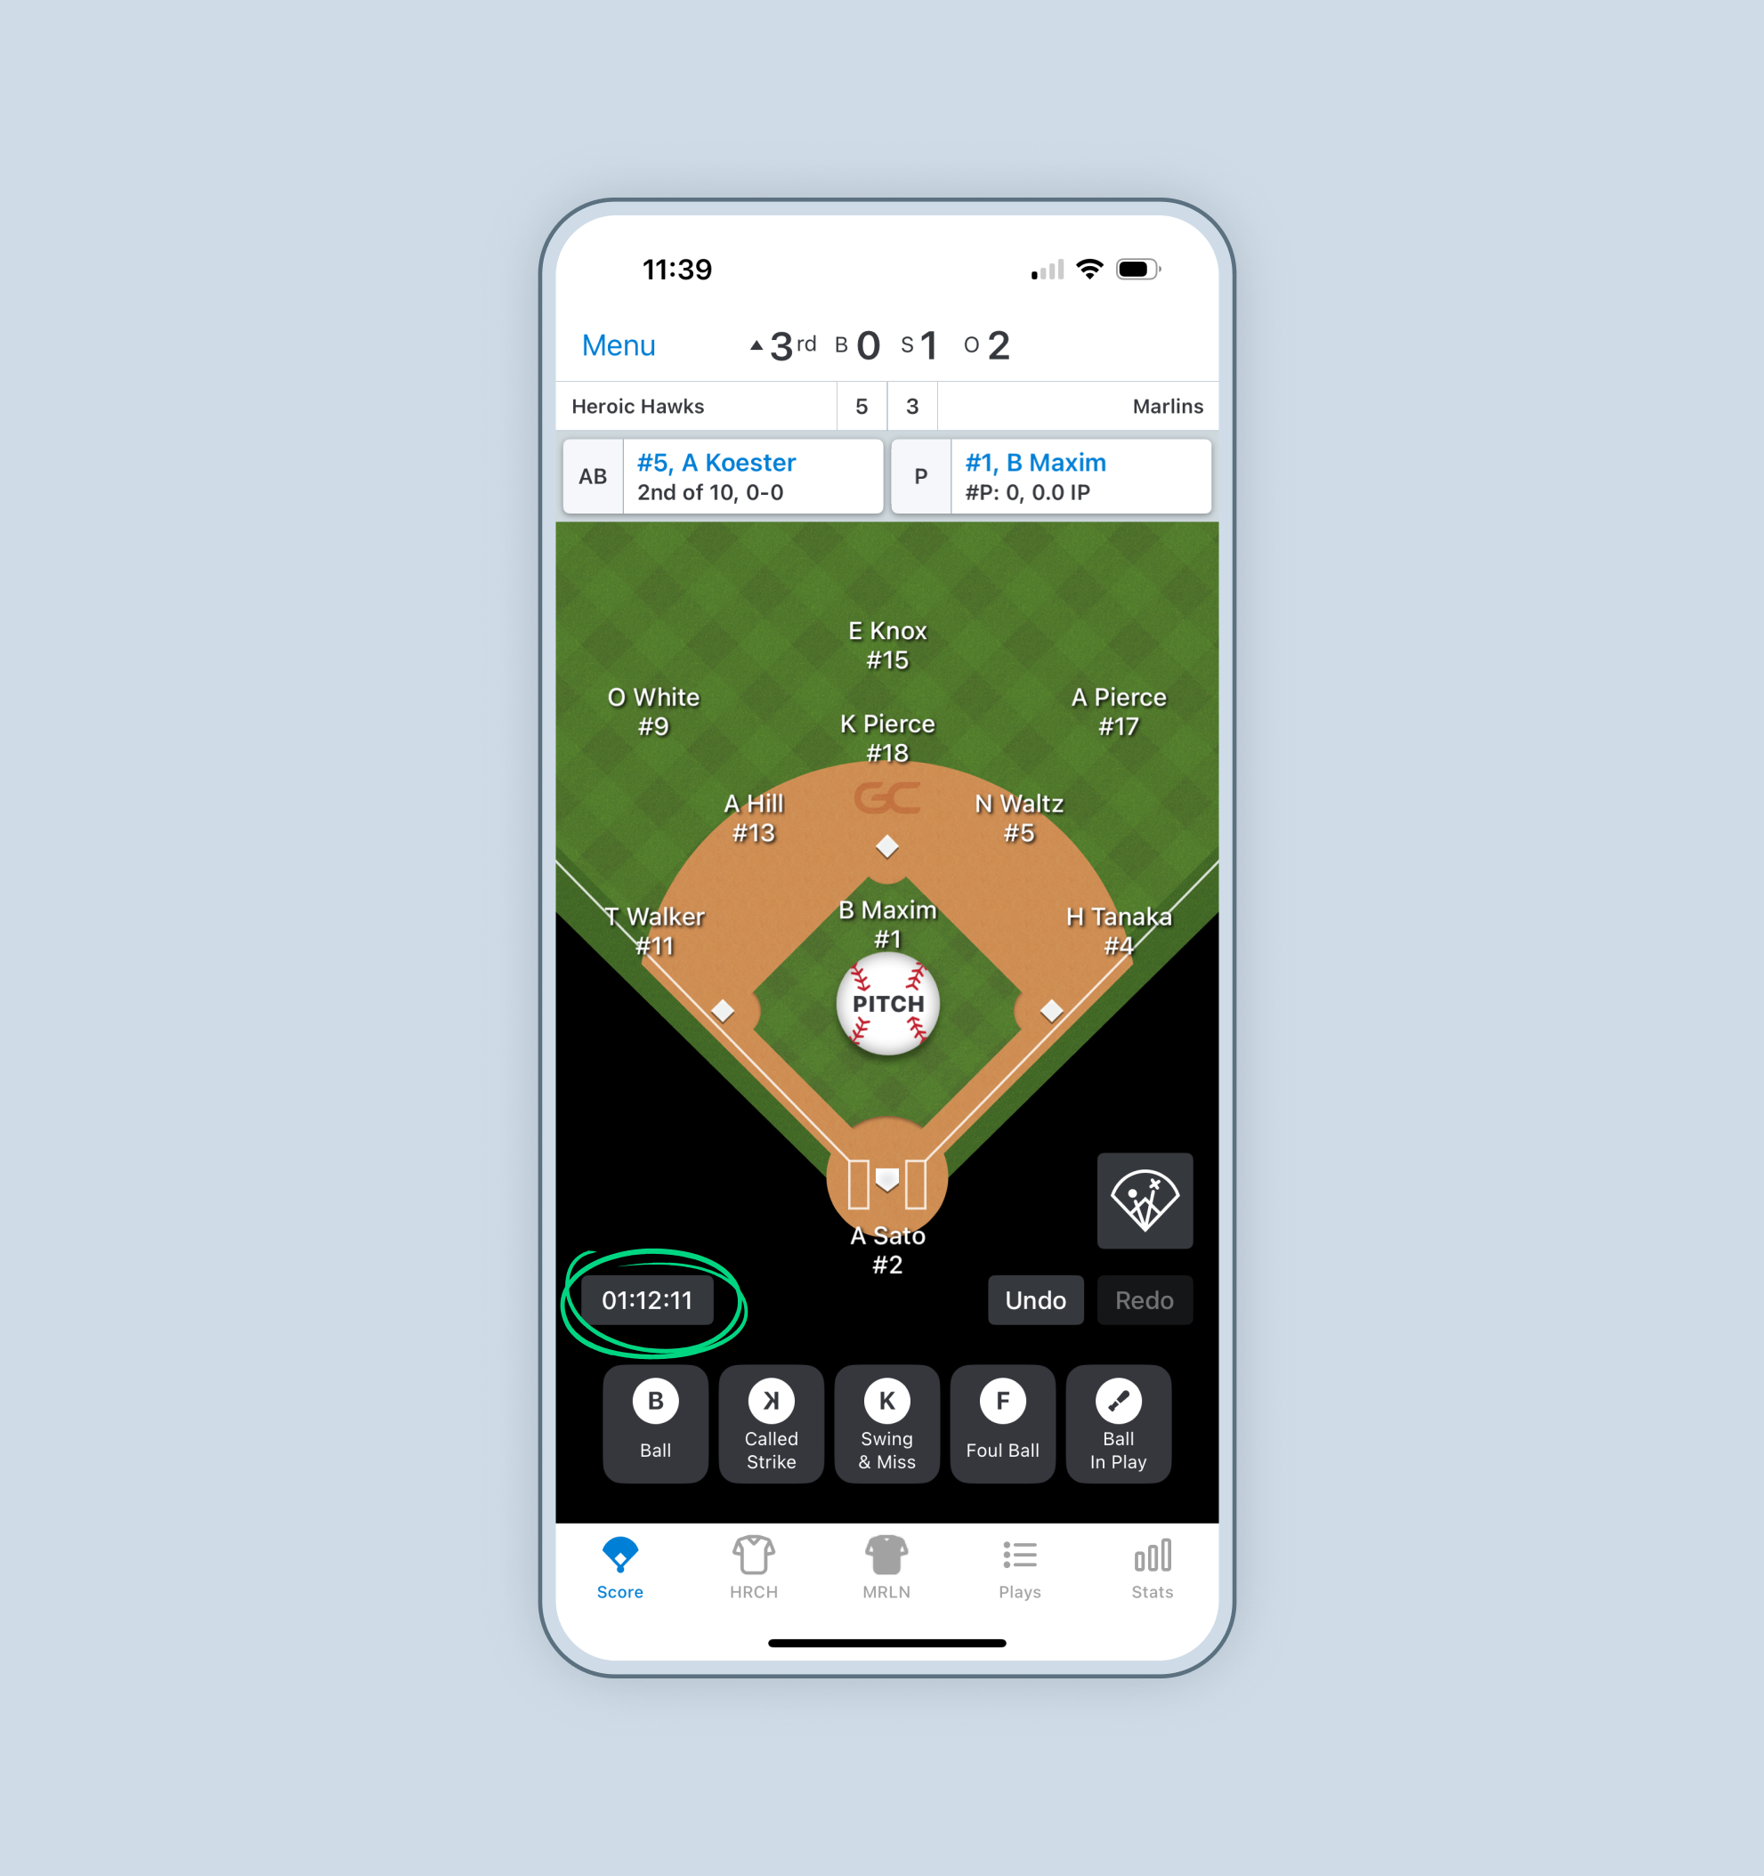
App Preview

Slide 9
Lineups
Getting Things Set Up

Slide 10
Starting Lineups
Managers for both teams should pre-fill their lineups into GameChanger.
Additionally, after the plate meeting, managers should provide a lineup card to the scorekeeper including names, numbers, and starting positions.
Scorekeepers should check lineups are entered from both teams by entering scorekeeping mode and clicking “My Team” and “Opponent at the bottom of the screen.
*In order for the game to start smoothly, lineups should be completed prior to first pitch

Slide 11
What if lineups are not there?
After entering scorekeeping mode, use My Team and Opponent screens to manage lineups during the game.
Tap Add From Bench to add existing players to the lineup or create a new player.
Adjust the lineup by tapping and dragging the player cell from the righthand side.
Tap on the player’s name directly to make more changes like adding a position or sub them out of the lineup.
From the player’s page, you can also set DH or DP/Flex.

Slide 12
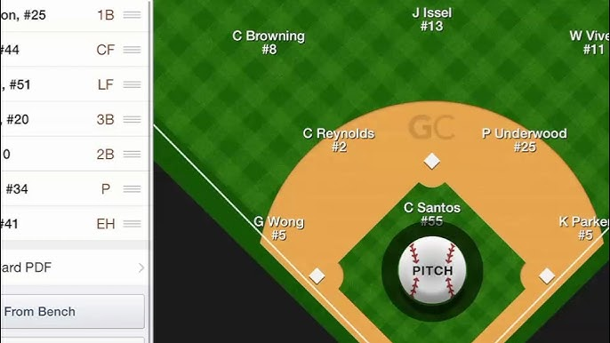
What if a team has more than 9 players?
WLL utilizes a continuous batting order where all players bat in the lineup.
Players not on defense will show up with “EH” as their position.

Slide 13
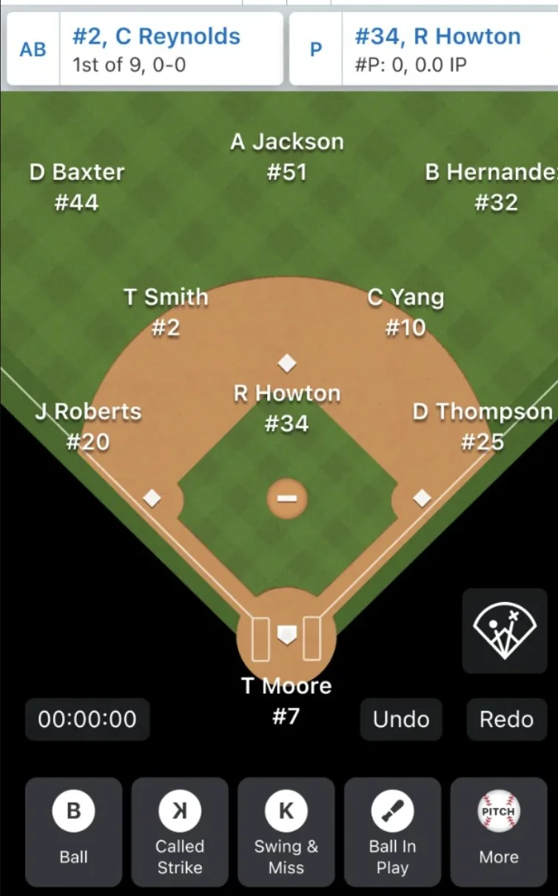
Does it matter if I put players’ positions?
Switching from paper scorebooks to GameChanger unlocks additional stat collection and visibility for teams and the league.
By accurately reflecting player positions, this allows the full functionality of GameChanger to be harnessed.
Scorekeepers will be responsible for ensuring player positions are reflected correctly.

Slide 14
Starting/Scoring a Game
Lets Play Ball!

Slide 15
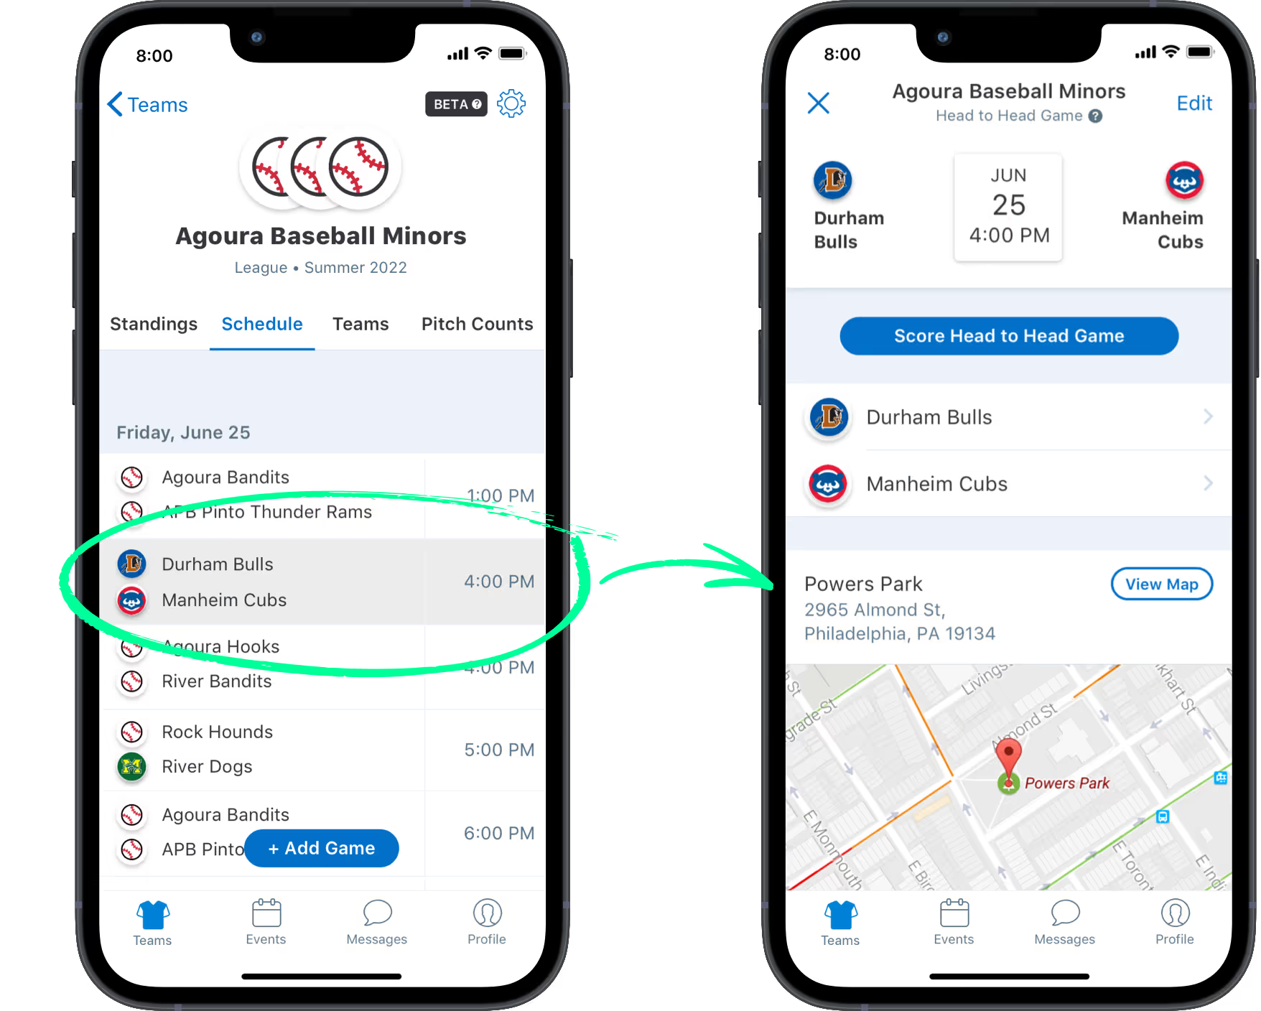
Starting a Game
Scorekeepers should be in place behind home plate at least 15 minutes prior to game time.
From your team’s Schedule Screen or from the League Tile, click on the game you want to score.
On the resulting screen, click the blue “Score Head-to-Head Game” button.
Start the Game Clock in the bottom left corner when the umpire tells you “Game time is…” or upon the Umpire saying “Play Ball” and being ready for the first pitch.

Slide 16
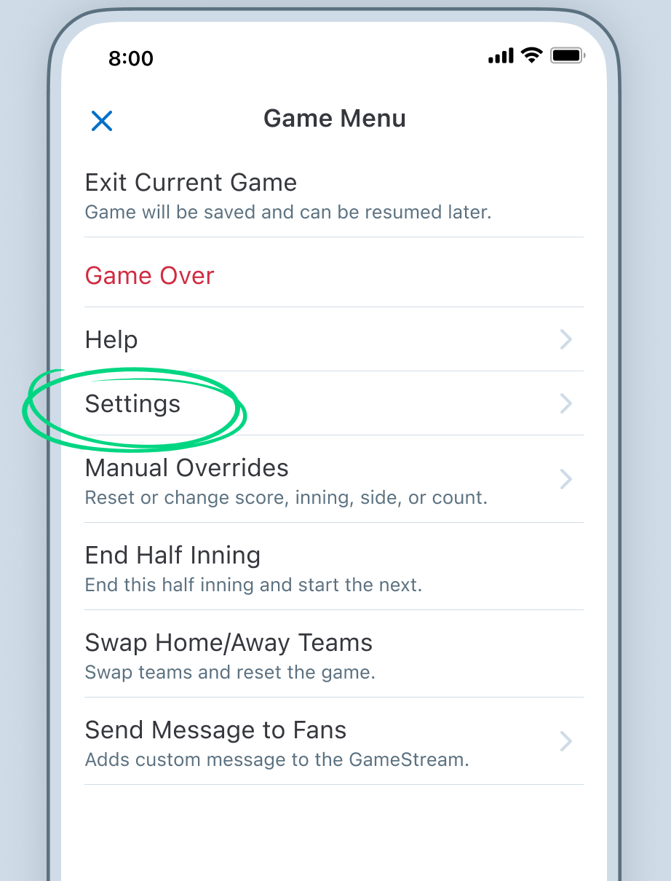
Game Settings
There are various settings that can be changed to better reflect the game being scored.
Click “Menu” in the top right corner to access the following:
Exit Current Game – Used to end the current game. It can be resumed later if needed or finalized.
Settings – Access various additional settings (next slide).
Manual Overrides – Allows you to manually change the score, inning, outs, balls, strikes, and half inning.
End Half Inning – End the inning and start the next inning (e.g. 5 run rule met).
Swap Home/Away Teams – Use this if the home and away teams are showing incorrectly.

Slide 17
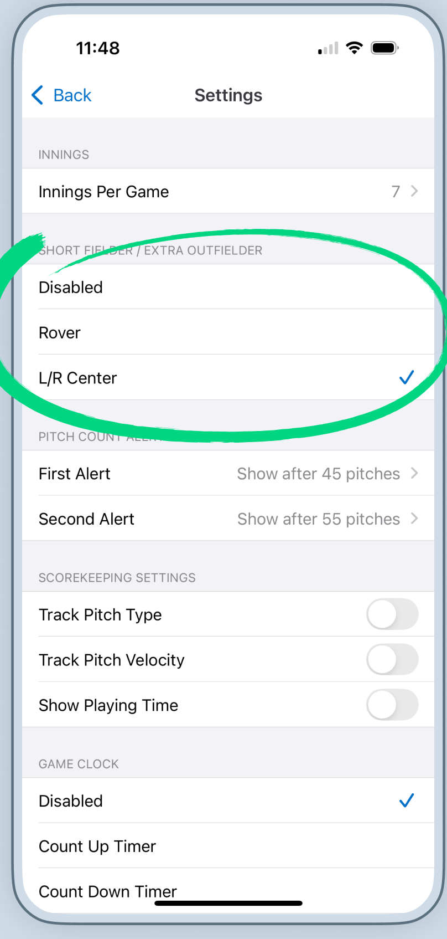
Game Settings
Settings you can modify:
Innings Per Game – Modify to 6 or 7 innings depending on division
Short Fielder/Extra Fielder – Keep disabled
Pitch Count Alert Limits – Add first and second alert for pitch counts
1st alert = 50 pitches (2 days rest)
2nd alert = 65 pitches (3 days rest)
Scorekeeping Settings – Do not modify
Game Clock – Choose whether the clock counts up or down.

Slide 18
Scoring a Game
You will now score each pitch and play similar to recording it into a paper scorebook.
Each time something happens on the field you will use the various buttons to record the outcome.
Clicking “Pitch” in the middle of the screen or “Ball in Play” on the bottom row brings up additional options.
Play can move fast, but do not feel rushed to click in real time. Let the play finish and then record what happened.

Slide 19
Scoring Basic Plays
Fair Ball!

Slide 20
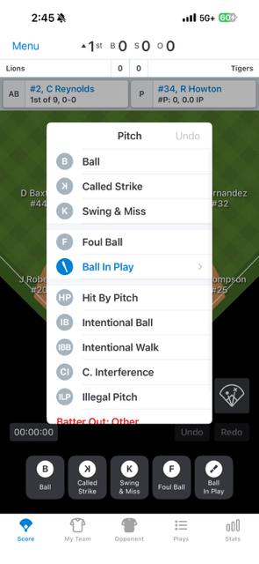
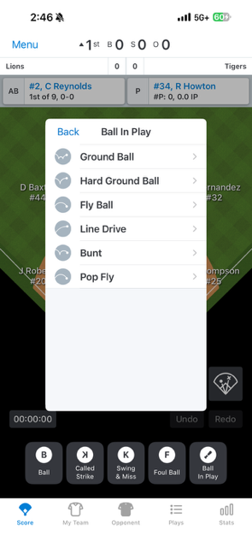
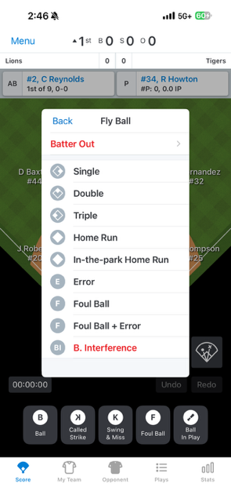
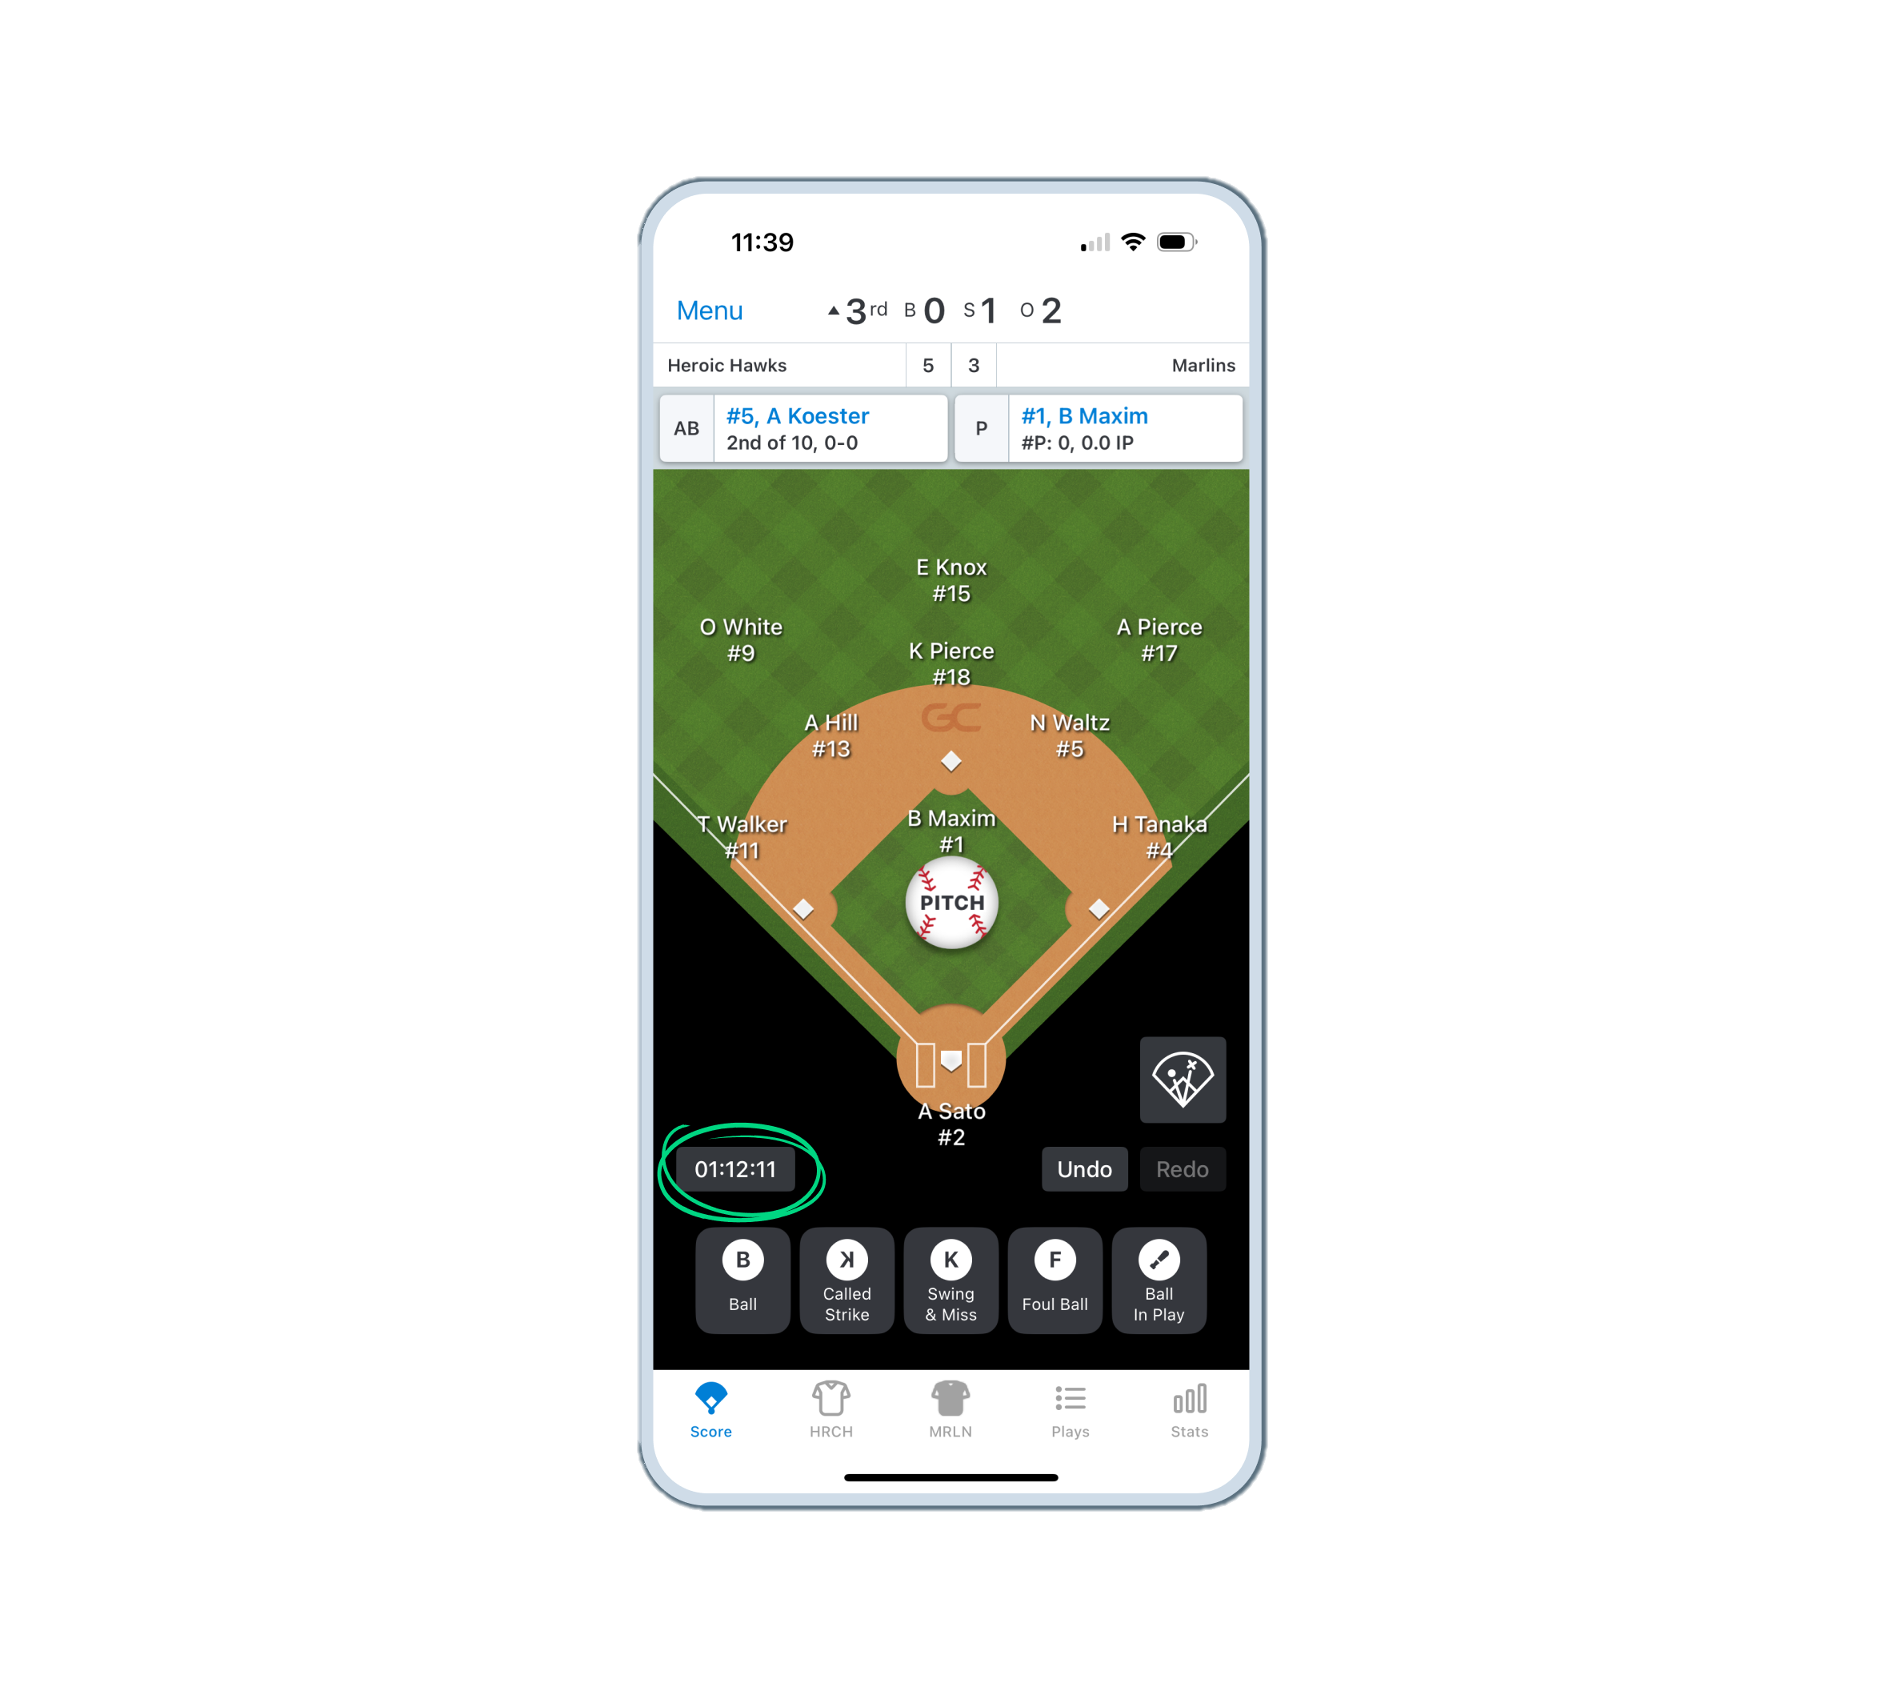
Basics
For each pitch a batter sees you will select an outcome. There are quick outcomes along the bottom of the screen, or you can click “Pitch” in the middle of the screen.
Ball
Called Strike
Swing & Miss
Foul Ball
Ball in Play
Additional outcomes like HBP, Intentional Walk, Catchers Interference and Illegal Pitch
Ball in Play – This gives you another set of options for outcomes. Select what time of contact the batter made for more.
Record the outcome of balls in play (i.e. single, double, error, etc.

Slide 21
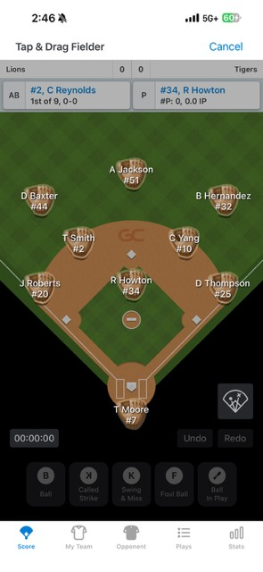
Where did the ball go?
Each time you select Ball in Play and move through the sub screens, you will end up with a screen showing gloves at each position.
Click and hold whoever fielded the ball and drag them to where the ball ended up.
If a player was out on a throw, you will then click where the fielder threw the ball and click done.
If no throw was made, you will click done and move to the next play.
If runners advance and they are not showing at the correct base, after you click done you can click and drag the runner to the correct base and drop it on Safe or Out.
You will then get a pop up of how they were safe or out. Choose the correct play or click other if none match up.

Slide 22
Stolen Bases/ Passed Ball/ Wild Pitch
When a player on base moves to the next base without the ball being put in play it will occur by one of four options:
Stole base – Catcher has the ball, throws down and the runner is safe OR the catcher didn’t throw because they would not have gotten the runner out.
Defensive Indifference – The pitcher and catcher let the runner steal (i.e. let runner steal 2nd because another runner was on 3rd).
Wild Pitch – The pitcher threw a pitch that was uncatchable by the catcher.
Passed Ball – The pitcher threw a pitch that was catchable with normal effort by the catcher, but they missed it.

Slide 23
Division Specific Plays
AAA and Majors
Leaving Early – Return the player to the base they were at previously.
Illegal Pitch – Click “Illegal Pitch” and then “Don’t Advance Runner”
*Infield Fly (Majors/Juniors) – Only use if the umpire calls this. Click Pop Fly>Batter Out>Infield Fly, and score accordingly.
Juniors
Pickoffs – Drag the runner away from the base and drop them on the correct outcome (safe/out).
Safe – Click “Attempted Pickoff”
Out – Click “Picked Off” and click the Pitcher icon and then who he threw the ball to.
Balk – Click “Illegal Pitch” and then “Advance Runner”
Dropped 3rd Strike – When this situation is in play a new option will show up. If there is a dropped 3rd strike, click that option and score the result.

Slide 24
Making Substitutions
Time for a Change

Slide 25
Player Position Tracking
A new GameChanger feature for 2026 is Player Position Tracking.
Player position tracking allows team Staff to see exactly how many innings each player has spent at each defensive position, both during a game and across the season. This helps monitor player workload, ensure balanced playing time, and document where players are gaining defensive experience.
This feature relies on accurate recording of who is on the field via substitutions.
Managers are being instructed to notify scorekeepers of defensive changes between innings.
Keep an eye on jersey numbers and that they are reflected accurately.
If you miss a change, make it as soon as you see it.

Slide 26
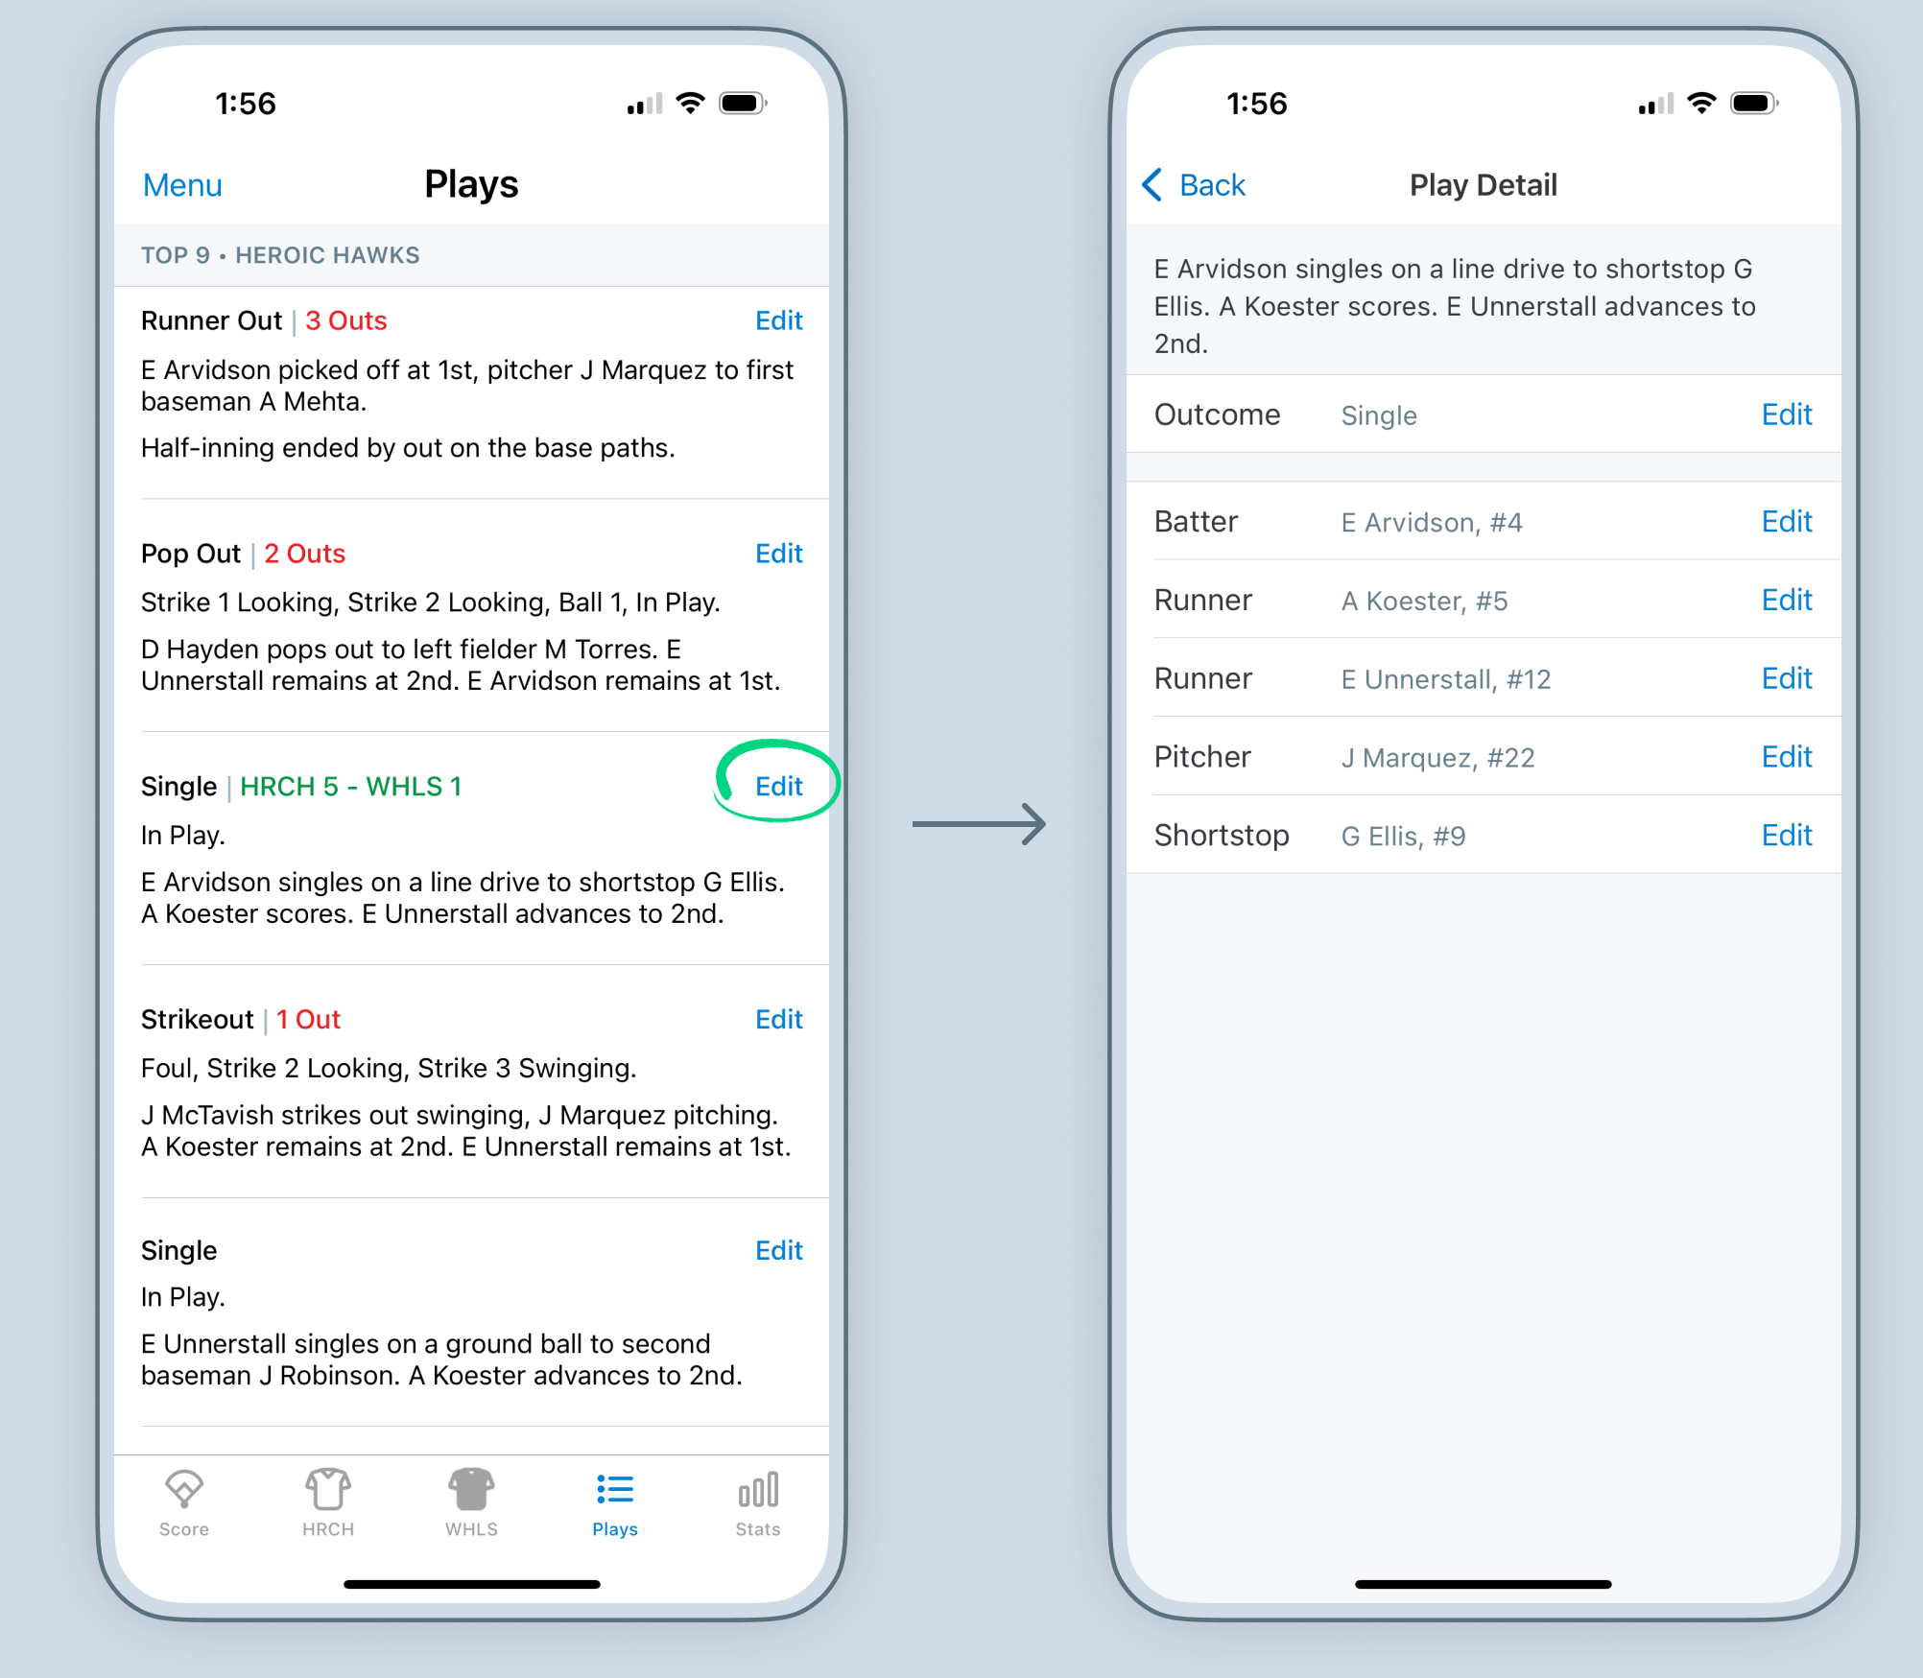
Pitchers and Catchers
Pitchers and Catchers are the most important positions to track.
There are Little League rules regarding pitchers and catchers that managers must follow and accurately reflecting them will help ensure players are not being over used.
If you miss changing a pitcher, you can edit plays to correct it.
When you edit the pitcher or another defensive player, that edit will take place for the remainder of the game, or until that player was substituted out.

Slide 27
Making Changes - Defense
To make defensive substitutions click on the position of the player coming out.
Click on the player that will be going into that position.
If they were previously in a different position (i.e. 3B going to LF) their previous position will show as empty. Fill that position with the new player.

Slide 28
Making Changes - Offense
Occasionally, a team will make an offensive substitution for baserunners.
Situation: With two outs, a team may put in a courtesy runner for the Pitcher and/or Catcher.
Click on the runner being replaced, then “Courtesy Runner.” Select who will be taking their place.
NOTE: The runner should be the player who made the last out. Review the “Plays” tab to determine who should be the courtesy runner.

Slide 29
What happens if a player is late?
If a player is late to the game, they will not be included in the starting lineup and will remain on the “bench” in GameChanger.
When they arrive, the Manager must notify the scorekeeper and the player will be added to the lineup after the last batter.
Managers will not be allowed to keep a player who is not present in the lineup who has not arrived and state “they will be here.”

Slide 30
What happens if a player gets hurt or sick?
If a player cannot continue the game, they can be skipped in the batting order.
If a player becomes ill, injured or is ejected during their at-bat, the next player in the lineup replaces them and assumes their at-bat.
Click the player’s name near the top of the screen and select “Skip to Different Batter,” then select the next player in the lineup.
If a player becomes ill, injured or is ejected while on base, they must be replaced by the player who made the last out.
Click the player being replaced and select “Courtesy Runner,” then select the player who made the last out.

Slide 31
Ending a Game
That’s the ballgame!

Slide 32
The Game is Over, Now What?
The game will end in one of the following ways:
Time Limit Reached – When your division’s time limit is reached, the umpire will call “Game”
Mercy Rule – When your division’s run rule, or Mercy Rule, is reached the umpire will call “Game”
Inning Limit – When your division’s inning limit is reached, the umpire will call “Game”
Once you have reached the end of your game you will be notified in the app. You will be instructed to go to the Game Menu and tap “Game Over”
Pitching Decisions – You will be given the option to assign pitching decisions (win, loss, save). Let the managers figure that out.

Slide 33
Let’s Practice

Slide 34
Practice Scoring a Game
From your team’s tile, click the settings cog in the top right corner, then click “Practice Scoring a Game”
https://www.youtube.com/watch?v=hScrgWsDhLc

Slide 35
Resources

Slide 36
Online Resources
GameChanger University Scorekeeping Training
GameChanger Help Center - Baseball/Softball General Scorekeeping
Little League GameChanger FAQs

Slide 37
Questions & Answers

