Slide 1
Manager & Coach
Safety Training 2019
Navigation: Use page up/down or arrow keys to move between slides. Press “Esc” to exit the slideshow.

Slide 2
Introduction
This training module provides an “overview” of the RWLL Safety Program.
It is not intended to be a substitute for reading and being familiar with the current “Safety Plan” which can be found the RWLL Website.

Slide 3
RWLL Mission Statement
REDMOND WEST LITTLE LEAGUE is a non-profit, all-volunteer organization whose mission is to Provide a structured Little League baseball and softball program designed to teach good sportsmanship and provide a wholesome recreational activity.

Slide 4
Safety - Our Managers and Coaches
Managers and coaches of Redmond West Little League are on the “front line” of our safety program. In addition to being thoroughly familiar with the RWLL Safety Plan, they are expected to know and follow these safety obligations:

Slide 5
Safety - Our Managers and Coaches
Background Checks
Prior to the team’s first practice, (a) each manager and coach must provide to the Safety Officer a completed Volunteer Form and the required supporting documentation, and (b) the manager must obtain confirmation that the background check for the manager and each coach has been completed and approved.
Volunteer Forms and supporting documentation can be found on our website and may be mailed to the Safety Officer’s and League President’s attention at the following address: president@redwestLL.org
Volunteers whose background check has been returned, reviewed, and approved are posted on the League’s website as an “approved member”

Slide 6
Safety - Our Managers and Coaches
All Managers and Coaches are required to complete CDC online Concussion Protocol training yearly.
Training Location: https://www.cdc.gov/headsup/youthsports/training/index.html
Action: After online training has been completed, please fill out the information to obtain an Online Training Completion Certificate. Please e-mail your certificate to Safety@redwest.org to complete the process.

Slide 7
Safety - Our Managers and Coaches
Fundamental Skills Training
At least once annually, the manager from each team must attend at least one training session on the fundamentals of playing baseball or softball, as the case may be.
Safety Training
At least once annually, the manager and/or at least one coach from each team must complete Online Safety Training, review the current training plan and complete the post-training quiz.

Slide 8
Safety - Our Managers and Coaches
First Aid Kits
Each team must have a fully stocked first aid kit on hand at every practice and game. The League supplies first aid kits which are distributed at the equipment hand out. The league requires managers to maintain the first-aid kit and encourages managers to contact the safety officer should additional supplies be needed. Also, the League maintains additional Cold Packs in the Field 1score booth at the Hartman Park complex.

Slide 9
Safety - Our Managers and Coaches
Medical Releases
During registration, parents are required to fill in medical release information about their son/daughter. The manager will be given a print out of this information for the entire team.
Managers and coaches must carry this medical information to every practice and game in the event a medical emergency arises. Failure to maintain these forms and have them immediately available is not acceptable and may result in a manager’s suspension and/or replacement.

Slide 10
Safety - Our Managers and Coaches
Unsafe Conditions and equipment
The manager or a coach must inspect the team’s and players’ gear, as well as the playing field, prior to any scheduled practice or game to determine fitness for play. If any condition poses a threat to safety, the condition must be resolved before play begins. Similarly, play should be terminated immediately if changing conditions make continued play unsafe.
Helmets should not be painted or have stickers applied unless approved by the manufacture. An approval letter must be supplied to the umpire.
Bats must have the USA Bat logo or be wood to be used in any event.
In the Event of Lightning or Thunder!
While relatively uncommon in the Pacific Northwest, if lightning is visible or distant thunder exceeds the volume of normal conversation, play MUST be discontinued for at least 30 consecutive minutes of no lightning or thunder. During this time, players shall be evacuated to vehicles or other safe areas, avoiding metal fencing (including dugouts) and wooded areas. This requirement is MANDATORY and will be enforced by the manager at practice or before the Umpire arrives and the Umpire of the game once he is at the field.

Slide 11
Safety - Our Managers and Coaches
Reporting Safety Risks
Managers are expected to report any unsafe conditions that pertain to fields or facilities to our League’s Fields Coordinator and Safety officer. Likewise, managers shall seek to replace any unsafe equipment without delay by coordinating with our League’s Equipment Coordinator. Known safety risks besides those involving fields or equipment should be brought to the attention of the Safety Officer or, if pertaining to the conduct of other League volunteers, the League’s President, Safety Officer and as needed the Player Agent shall become involved.

Slide 12
Safety - Our Managers and Coaches
Adult Supervision
No less than two approved volunteer adults should attend every team event from beginning to end. A manager or coach who needs to deal with an emergency must focus on an injured player and is for that reason unable to supervise the other children. A second adult is needed to provide this support. A cell phone shall be available at all contacts for emergency purposes.
Safety Guidelines
A list of “common sense” safety guidelines that are contained in Appendix D of the League Safety Plan. Managers are expected to know and follow these guidelines throughout the season.

Slide 13
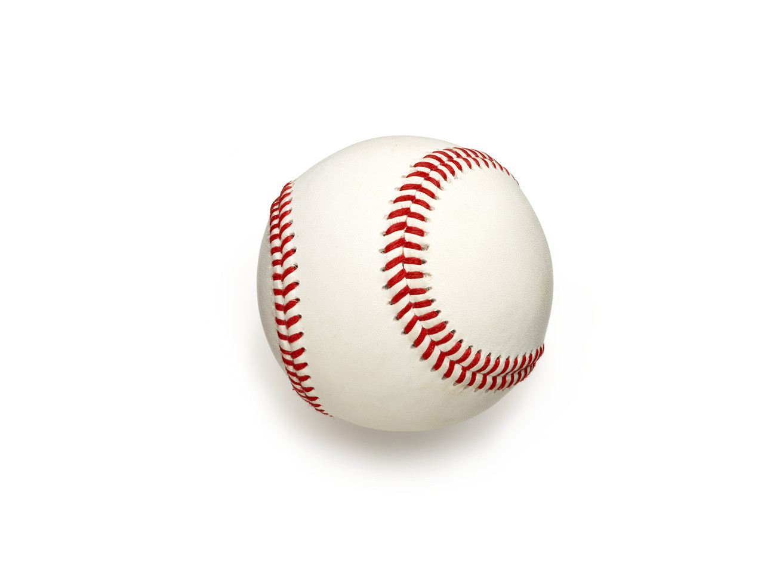
Safety - Our Managers and Coaches
Track Injuries
  Managers will report injuries to the Safety Officer within 24 hours of any incident by submission to the Safety Officer of a League Incident Injury Tracking form for each incident. Incident forms shall be retained for Little League use only in order to report safety hazards or unsafe practices, and to contribute to ideas about how to improve League safety in the future. Managers that fail to report injuries shall be subject to disciplinary action.

Slide 14
Safety - Our Managers and Coaches
Accident Reports (cont’d)
Report Potential Claims- In the event of an injury that may result in an insurance claim, Little League provides insurance that is secondary to a family’s own medical insurance, if any. If a player suffers an injury during a team contact that warrants medical care, Managers shall notify the Safety Officer and have the parent and the Manager fill out their respective parts of the insurance related claim form called “Accident Notification” Form. After completion, the form shall be submitted to the Safety Officer who shall then forward it to District 9 and to Little League International for processing. Accident Notification forms MUST be completed within 90 days of the injury.

Slide 15
Safety - Our Managers and Coaches
Accident Reports (cont’d)
  Physician release- Players whose activities have been limited by a physician must present a doctor’s release to the Safety Officer prior to returning to full playing status. Liability for all non-compliance with this requirement will lie with the player’s parents. Additionally non-compliance may result in the suspension of the manager, and the player.

Slide 16
Safety - Our Managers and Coaches
About Head Injuries and Concussions!
A player who sustains a head injury requires special attention. Not only shall the manager or coach follow the normal procedures for reporting the injury to the Safety Officer, but the parents of the Player shall be alerted immediately to both the injury and the need to monitor the child closely for the next succeeding 24 hours. It will be the decision of the parents to seek medical attention. Every parent should be encouraged to read the “Parent- Athlete Concussion Information” document found on the Safety page on the league’s website.

Slide 17
Safety - Our Managers and Coaches
First Aid Basic Training
Avoidable Injuries
Do not permit bat swinging in the dugout or outside the batting cage (this includes the use of “batting sticks”). If there is a bat in the hand of a RWLL player, helmets will be on surrounding players. Teach players to be aware of their surroundings that no teammate or any other player is within striking distance when swinging the bat.
Teach players to only throw a baseball from one player to another when eye contact and or voice contact has been made.
Teach players to “turn away” (i.e., toward the catcher & backstop) from a pitch that is going to hit them to avoid getting hit in the face, chest or groin area.

Slide 18
Safety - Our Managers and Coaches
First Aid Basic Training
Injury Assessment
1. Approach and form a general impression of player’s condition (hurt/not hurt)
2. Note the mechanism of injury (what hurt the player)
3. Check mental status (If unconscious call 911 and give short report of what happened)
4. Check for ABC’s (Airway unobstructed, Breathing in and out, Circulation (pulse) is felt.
5. Observe Skin color (pink) and feel temperature (warm/dry; cool/clammy, etc.)
Bodily Fluid Protection
1. Always wear your rubber gloves when dealing with blood or any other bodily fluids on another person. These are provided in the first aid kit.
2. Each score shack will contain a blood borne pathogen disinfectant spray bottle (Hypochlorite) that is used to kill all blood borne pathogens and disinfect the area and a bottle of water to generously flush the area.

Slide 19
Safety - Our Managers and Coaches
First Aid Basic Training- Initial Treatment of Common Injuries
NOSE BLEEDS: Pinch both nostrils together, leaning forward in a tripod position for 5 MINUTES. Place ice at the bridge of the nose.
DISLOCATED FINGERS/JAMMED FINGERS: Wrap ice on joint loosely to prevent further injury. Elevate injured area and have parents seek medical treatment. Dislocations are corrected in a hospital setting only, never in the field.
SPRAINS: Point tenderness and swelling. Wrap ice above and below injury site and elevate above the heart. Continue with ice for next 24 hours.

Slide 20
Safety - Our Managers and Coaches
First Aid Basic Training- Initial Treatment of Common Injuries
STINGS/INSECT BITES: Clean the area with mild antiseptic and apply ice with wrap. If it is a bee sting with the stinger still in skin, scrape the area with the edge of a stiff object like a credit card to remove the stinger.
WARNING! We live in an area with Black Widow and Brown Recluse Spiders that can deliver a life-threating bite. If there is significant swelling, a change in behavior or a decreased Level of Consciousness- Call 911.
ANAPHYLATIC SHOCK- Call 911. A reaction to something that the player is acutely allergic to that will cause a severe allergic reaction. Signs can be a flushed face and chest, trouble breathing and dizziness and can occur within seconds. The player or their parent(s) should carry an epi-pen (epinephrine) with them at all times and will know how/when to use it. Keep a watch on this/these players at all times.

Slide 21
Safety - Our Managers and Coaches
First Aid Basic Training- Initial Treatment of Common Injuries
BLEEDING: Control or stop external bleeding, apply direct pressure dressings on site and elevate. Do not remove dressings once applied- apply additional dressings if needed. Call 911.
FACE, EYES, TEETH AND THROAT: These areas have a rich blood supply and will bleed a lot. If the trauma is to an eye or nearby area, do not put pressure on or manipulate the eye in any way. Cover both eyes with moist dressing (pour water on a 4x4 gauze) to minimize movement on the injured side. CALL 911.
If teeth are broken, apply direct pressure with dressings to the injury, collect and place any found teeth in a container/plastic bag with the persons own saliva. Always ensure that the player can breathe and have parents seek medical care or CALL 911 for emergency transport.

Slide 22
Safety - Our Managers and Coaches
First Aid Basic Training- Initial Treatment of Common Injuries
SEIZURES: Know your players physical medical conditions, allergies and any medications. Seizures usually only last a few minutes at most. Because most seizures involve a vigorous twitching of the muscles they use up a lot of the body’s oxygen and can affect circulation causing the person to turn blue. Keep all objects away from the person and do not touch them. Once the seizure has stopped, the players muscles will relax and breathing will become fast and deep which will balance the reduced oxygen and circulation. Know if you have a diabetic player and make sure to have a discussion with their parent(s) regarding their medication schedule and ensure that they are good to go for each practice and game.

Slide 23
Safety - Our Managers and Coaches
First Aid Basic Training- Initial Treatment of Common Injuries
FRACTURES- VISIBLE AND SUSPECTED Any suspected fracture (swelling, high level of pain, deformity and false motion) or visible fracture needs to be transported in a timely manner to a medical center with a pediatric orthopedic surgeon. Kids under the age of 16, growth plate fractures are most common and these injuries are especially common around the: wrist, elbow, knee and ankle, which require the attention of an orthopedic physician.

Slide 24
Safety - Our Managers and Coaches
First Aid Basic Training- Initial Treatment of Common Injuries
SHOCK is a condition, especially children, in which may vital functions are slowed down or seriously depressed (pour body perfusion) after any injury especially FRACTURES or SEVERE BLEEDING. SYMPTOMS: weakness, pale, cold, clammy skin, rapid and or weak pulse, beads of perspiration on forehead/palms, nausea and irregular breathing. TREATING SHOCK by keeping victim warm and lying down, elevate feet if no neck/spine injury is evident. Keep victim’s airway open. If vomiting occurs, turn victims head to the side for discharge. If conscious, not nauseated and able to swallow, give small sips of water.

Slide 25
Safety - Our Managers and Coaches
First Aid Basic Training- Initial Treatment of Common Injuries
HEAT ILLNESSES
HEAT CRAMPS (Stage 1 of Heat Illness) occur in the legs and stomach after exercise in high temperatures. Cramps are usually very painful and kids may feel even sick and not know why their muscles are hurting.
TREATMENT: Bring to cool area and hydrate.
HEAT EXHAUSTION (Stage 2 of Heat Illness) - More serious than cramps. Cool, moist, clammy skin with dizziness and headaches. The skin may or may not be hot.
TREATMENT: Lie the player(s) down in a cool, shaded place. Give small amounts of water every 30 minutes. Loosen/remove tight clothing and apply cool packs (ice packs wrapped in cloth) under arms and wrists. If player vomits, refuses water or has a decreased Level of Consciousness Call 911.

Slide 26
Safety - Our Managers and Coaches
First Aid Basic Training- Initial Treatment of Common Injuries
HEAT ILLNESSESES (cont’d)
HEAT STROKE (Stage 3 of Heat Illness) and the most serious- Call 911. It is life-threatening and ALWAYS requires emergency medical attention. Signs are: high body temperature/skin very hot. Vomiting, decreased Level of Consciousness or unconscious, weak pulse, and shallow breathing.
TREATMENT (after calling 911): Move person to a cool place, wrap wet cold towels around the body and fan the person. Apply ice packs around ankles, wrists, armpits and neck to try and cool the larger blood vessels. Monitor their breathing at all times.

Slide 27
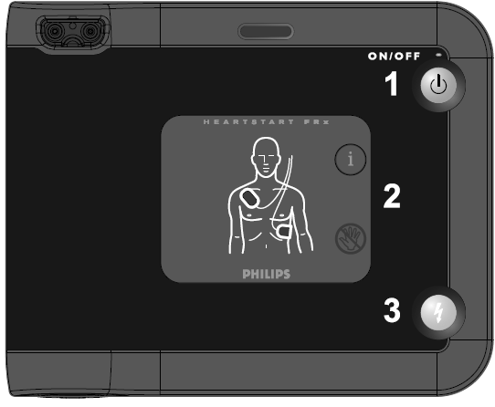
AED Use Instructions
AEDs are located in Hartman Park Field 2, 5, & 6 score booths and the Big Hartman score booth. They should always be unlocked anytime play is occurring at Hartman.
In the event of Cardiac Arrest and an AED is not available have someone start CPR and have another person call 911.

Slide 28
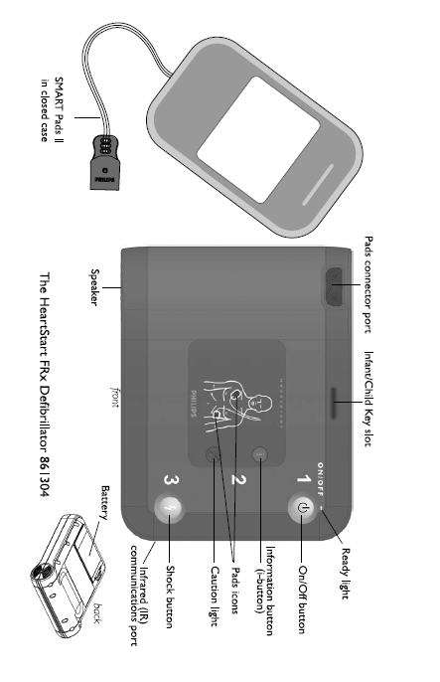
AED Use Instructions

Slide 29
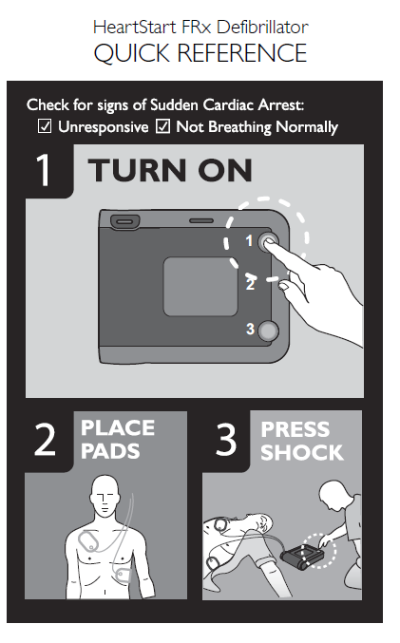
AED Use Instructions

Slide 30
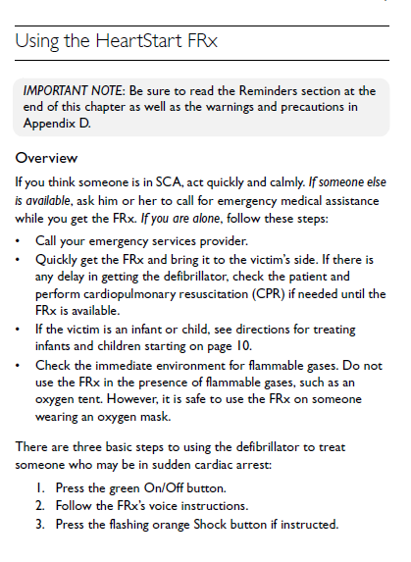

Slide 31
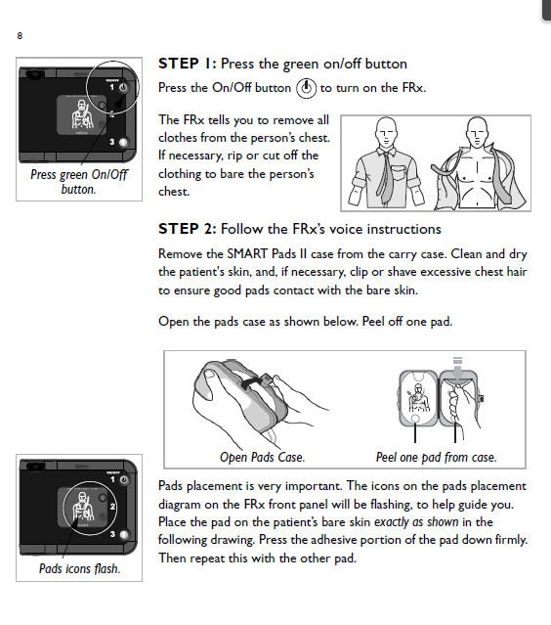

Slide 32
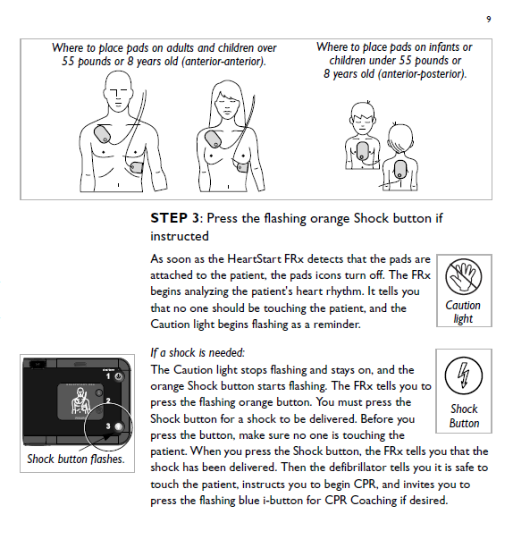

Slide 33
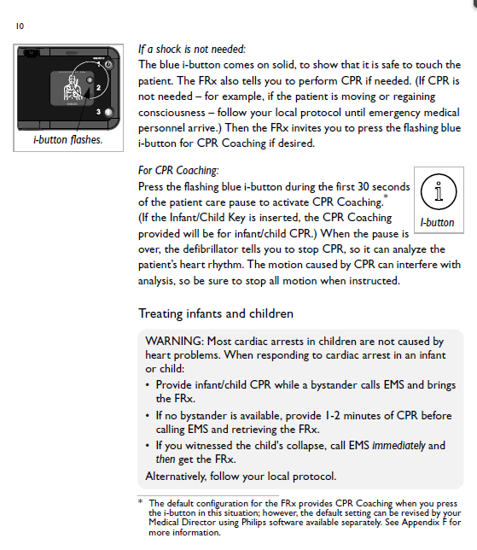

Slide 34
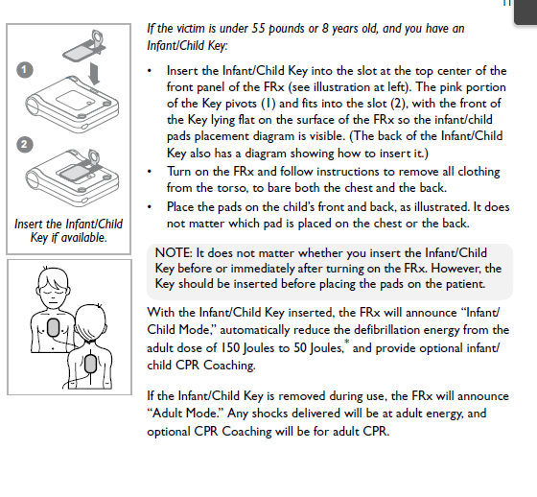

Slide 35
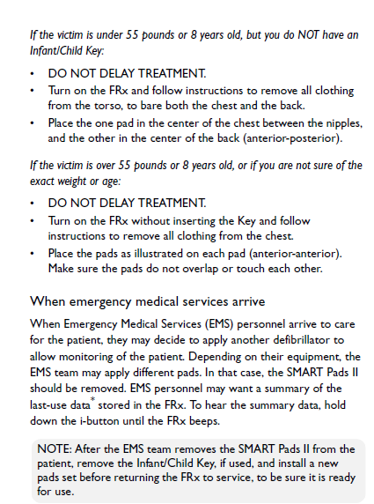

Slide 36
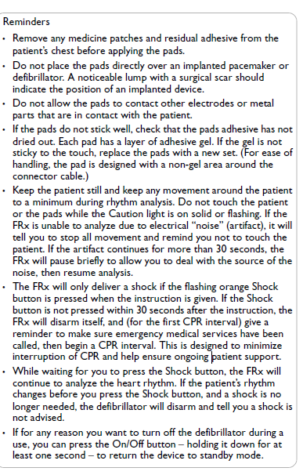

Slide 37
Use of AED’s
NOTE: Anytime that one of RWLL’s AEDs are actually used, immediate notification must be sent to the Safety Officer at safety@redwestll.org.

Slide 38
Conclusion
Be sure to take the Safety Quiz to receive credit for this training.
While this concludes the Safety Training presentation, every Coach and Manager is expected to read and be familiar with current Safety Plan which will found on this website.

Slide 39
Safety - Our Managers and Coaches
THE END

